Slide 1

Using a Shared User file in a Network Zone Consortia
Moshe Shechter, June 2024

Slide 2
Linked accounts

Slide 3
Linked Accounts
A fulfillment network workflow involves patrons on institution A requesting and receiving fulfillment services at institution B. For this purpose, the system supports the ‘linked accounts’
Linked accounts have two models:
  Cached user records that are automatically copied from institution A to institution B, retaining an explicit link to institution A
  Records created in institution B with a ‘consortial ID’ that is shared with the institution A record.

Slide 4




Model 1 – Cached Accounts
Institution A
Discovery
Request
Institution B
Login
Linked account

Slide 5
Model 1 – Cached Accounts
Institution A
Institution B
Borrow
Linked account

Slide 6
Model 1 – Cached Accounts
In this model there is a ‘Primary’ record and a ‘Secondary’ record
Institution A
Institution B
Primary
Secondary

Slide 7
Model 1 – Cached Accounts
… this allows for refresh actions from the Primary record to the Secondary record
Refresh happens when linked account is active – borrows or requests
  Updates are not pushed from Primary to Secondary the moment they are updated at the Primary record
Institution A
Institution B
Borrow/request
Primary
Secondary

Slide 8
Model 1 – Cached Accounts
What’s copied ?
  General Information
  Contact Information
  Blocks (optional) (more information here)
What’s not copied ?
  Notes
  Identifiers
Locally set rules determine (may be set per copy source):
  Local expiry date
  Local purge date
  Local user group
  Local resource sharing library

Slide 9
Model 1 – Cached Accounts
Source institution may configure
  What patron types (user groups) may have their data shared
  What data from the user record is shared and what is not
  More details are on the “Automated Fulfillment Network in a Network Zone Consortia” webinar delivered on June 5th

Slide 10
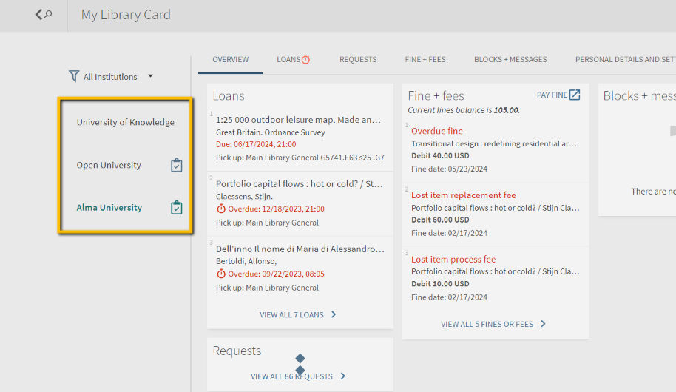
Model 1 – Cached Accounts
The fact that the accounts are linked allows:
  Refresh from Primary to Secondary record
  Unified single Primo library card
  Preload of user record in different institutions (direct login to all institutions)

Slide 11

Model 2 – Consortial ID
A shared Network Zone is mandatory. The ID type that will be used as consortial ID is configured in the NZ
Institution A
Institution B
ID=12345678
ID=12345678
SIS Feed
SIS Feed

Slide 12
Model 2 – Consortial ID
The fact that the accounts are linked allows:
  Refresh from Primary to Secondary record
  Unified single Primo library card
  Preload of user record in different institutions (direct login to all institutions)

Slide 13
Both models
In either case, each institution manages its users file independently of the other
  Locally managed purge actions
  Locally managed additional segments:
    Addresses
    Blocks
    Notes

Slide 14
Some Insights …

Slide 15
Some Insights …
Model 1 is a great fit for institutions that have no central management of the users.
  Each institution manages a separate users file
  Patron records are created in a just in time manner, only for patrons that require services at other institutions

Slide 16
Some Insights …
Model 2 is a great fit for institutions that have shared user file:
  Institutions that share an external identity management system. Usually that would be some statewide system
  Service providers that manage multiple institutions’ data, including their user management and fulfillment modules

Slide 17
Some Insights …
However…. Model 2 does not provide:
  Automatic refresh of data in all institutions
  Single load action of the user file, which needs to be fed into every institution independently
  Institution level user record management in a just in time manner

Slide 18
The Goal
Allow central management of users, to be used by consortia that are able to manage a single source file of users
Maintain synchronization of user information across the member libraries
Maintain options for independent fulfillment policies for each member library
Maintain independent fulfillment workflows at each member library

Slide 19
Central Model
The central model enjoys the benefits of:
  On going synchronization of data.
  Preload of user record in different institutions (direct login to all institutions)
The Network Zone is the vehicle for this model.

Slide 20
The Central Model –
Collaborated User Management

Slide 21
Central Model - Concepts
The Central Model is based on a single feed of users (SIS) being received at the Network Zone
There is no SIS feed at the member institutions
All users that are loaded at the NZ are exposed to the local member institution for performing fulfillment actions such as loan and return. In fact, the NZ record is fully accessible to the member institution for all purposes

Slide 22
Central Model - Concepts
When a user is active in any of the institutions, the user’s record is copied from the NZ to the member institution.
  Internally, Alma maintains a link between the member institution copy and the NZ managed copy
Every subsequent update (via an SIS feed) to the NZ managed record is automatically propagated to the members that have a copy of the record
Local segments (email address, phone numbers etc.) can still be managed at the member institutions

Slide 23
NZ Management of the user file – The SIS feed
SIS Feed
Network Zone
ID=12345678
Institution A
Institution B

Slide 24


NZ Management of the user file
Network Zone
ID=12345678
Copy/Refresh record
ID not found
Institution A
Institution B
Login
Request
Loan
ID
ID=12345678

Slide 25
NZ Management of the user file
SIS Feed
Network Zone
Copy/Refresh record
ID=12345678
Institution A
Institution B

Slide 26

NZ Management of the user file
Network Zone
SIS Feed
ID=12345678
Synch is using the same model as SIS synch – overriding external segments and leaving local segments
Synch
Synch
Local users
Local updates
ID=12345678
ID=12345678
Institution A
Institution B
Institution C
Purge is a local process

Slide 27
NZ Management of the user file
You can update the Network Zone users through the following processes:
    Using the Update/Notify Users job.
    Using an API.
    SIS can be run once in the Network Zone institution.
    Manually updating the user in the User Edit form
In all of these cases, the user record is updated in all Institution Zone members where the user record exists, i.e. has been previously pulled from the Network Zone.
The above mentioned processes update existing records at each member institution but do not create a new record for a user that does not exist in a member institution.

Slide 28
NZ Management of the user file
Sometimes users are loaded into Institution Zone separately from the Network Zone (for example, during the migration process).
It is possible to run the Link Institution Zone Users to Centralized Network Zone Users job, which will attempt to match Institution Zone users with Network Zone users, and if matched – link the users so that the Institution Zone users will get updates by any future changes performed to the Network Zone user.
It is recommended to have this job scheduled at the Network Zone to make sure Network Zone and Institution Zone records remain linked.

Slide 29
NZ Management of the user file
Note – It is possible to register the user at the IZ and push the update to the NZ.
However, updates to the record that are done at the IZ do not propagate to the NZ record
Note – Updating the user record from Primo updates only the local record, and has no effect on the NZ record
Local updates
ID=12345678
Institution A
Institution B

Slide 30
Workflows and Use Cases

Slide 31
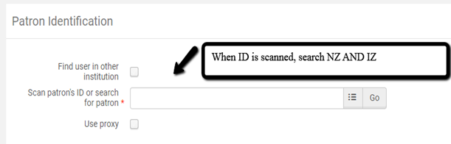
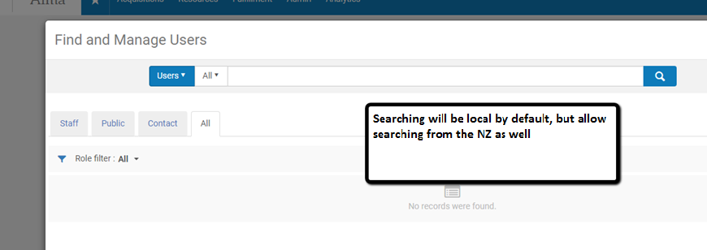
Workflows and Use Cases - Loan
User can borrow at institution A even though the user record currently exists only in the NZ. Alma will pull the user record into the local institution A list in order to successfully complete the loan action
Once user is found in NZ, the record is fully copied to the IZ

Slide 32
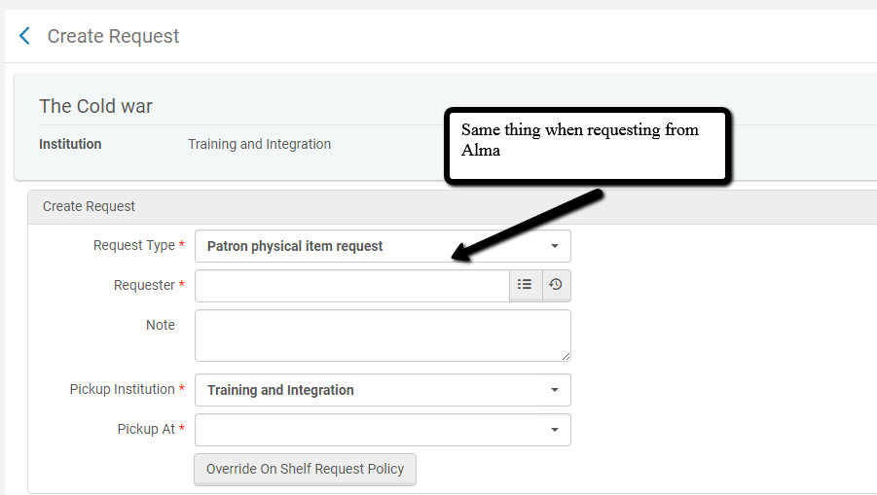
Workflows and Use Cases - Request

Slide 33

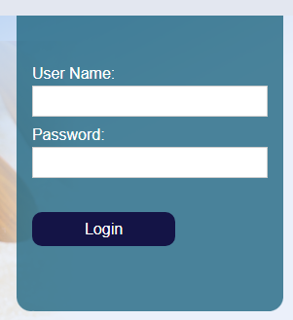




Workflows and Use Cases – External Login
ID
1
IZ User File
ID
2
NZ User File
User can login to institution A even though the user record currently exists only in the NZ. Alma will pull the user record into the local institution A list in order to successfully complete the authentication
ID

Slide 34
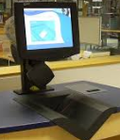
Workflows and Use Cases – Self Check
User can borrow at institution A even though the user record currently exists only in the NZ. Alma will pull the user record into the local institution A list in order to successfully complete the loan action
ID
1
IZ User File
ID
2
NZ User File

Slide 35

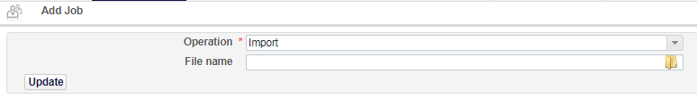
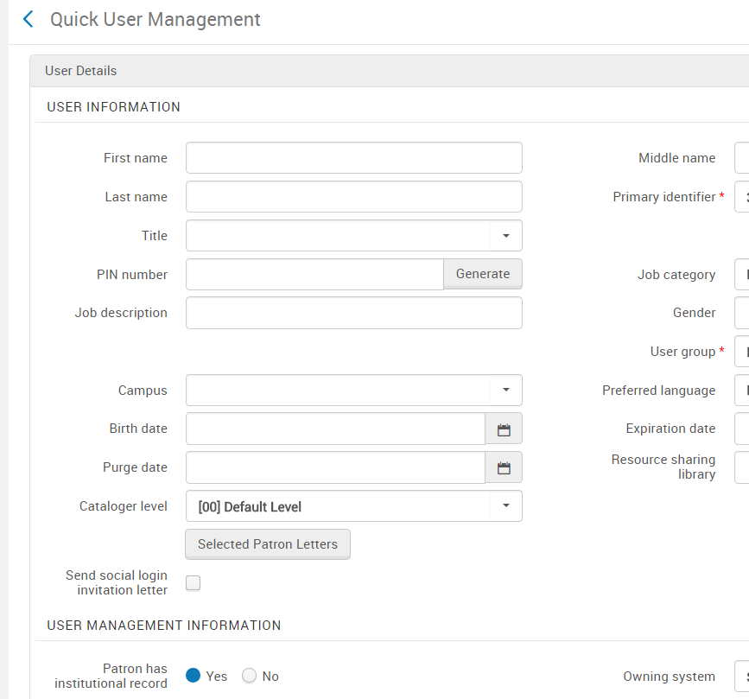
Workflows and Use Cases – Other Scenarios
Load Desk Operators
User Registration
Users Set from file

Slide 36
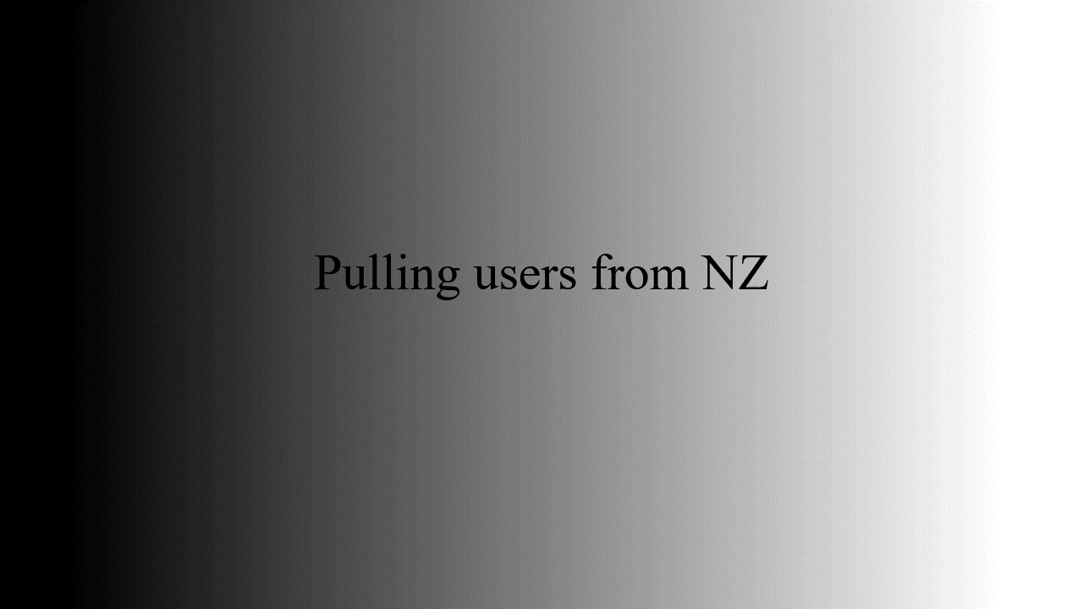

Slide 37
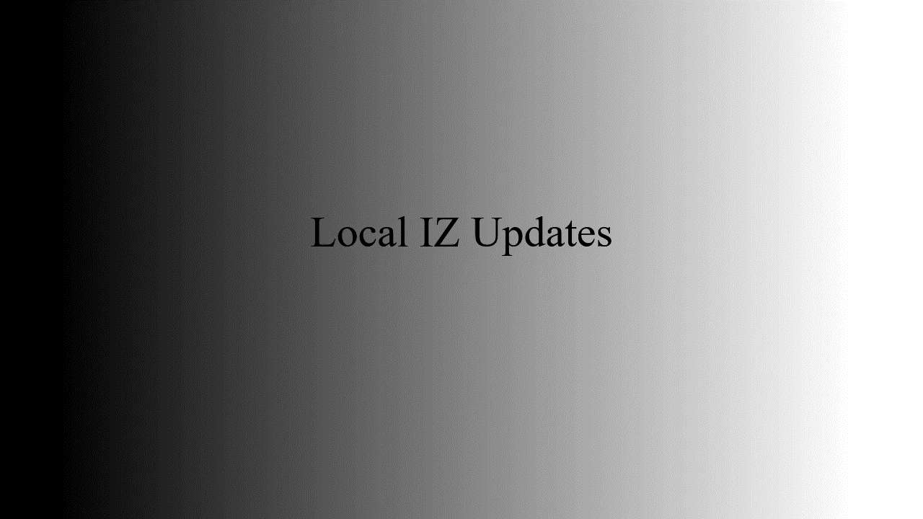

Slide 38
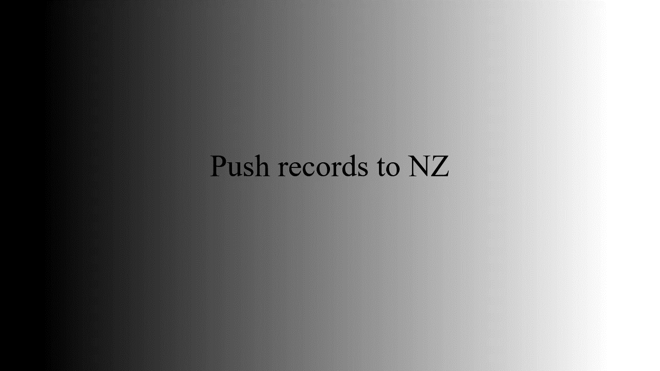

Slide 39
Thank You
Moshe Shechter
Moshe.shechter@clarivate.com

